Slide 1
Chapter 30
Convexity, Timing, and Timing, and Quanto Adjustments

Slide 2
Forward Yields and Forward Prices
We define the forward yield on a bond as the yield calculated from the forward bond price
There is a non-linear relation between bond yields and bond prices
It follows that when the forward bond price equals the expected future bond price, the forward yield does not necessarily equal the expected future yield

Slide 3
Relationship Between Bond Yields and Prices (Figure 30.1)
Bond
Price
B ₃
B ₂
B ₁
Y₃
Yield
Y₂
Y₁

Slide 4
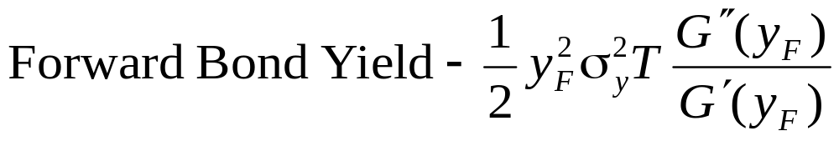
Convexity Adjustment for Bond Yields (equation 30.1)
Suppose a derivative provides a payoff at time T dependent on a bond yield, y_{T} observed at time T. Define:
G(y_{T}) : price of the bond as a function of its yield
y_{F} : forward bond yield at time zero
σ_{y} : forward yield volatility
The expected bond price in a world defined by numeraire P(0,T) is the forward bond price
The expected bond yield in a world defined by numeraire P(0,T) is (approximately)

Slide 5
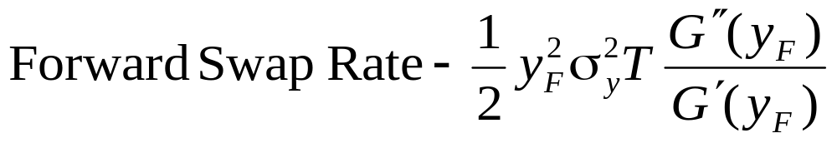
Convexity Adjustment for Swap Rate
The expected value of the swap rate for the period T to T+τ in a world defined by numeraire P(0,T) is (approximately)
where G(y) defines the relationship between price and yield for a bond lasting between T and T+τ that pays a coupon equal to the forward swap rate

Slide 6
Example 30.1
An instrument provides a payoff in 3 years = to the 3-year swap rate multiplied by $100
Payments are made annually on the swap
All swap rates are 6%; volatility is 22%
Risk-free zero curve is flat at 5% (with annual compounding)
The convexity adjustment is 9.7 bps so that the value of the instrument is 6.097/1.05³ = 5.27

Slide 7
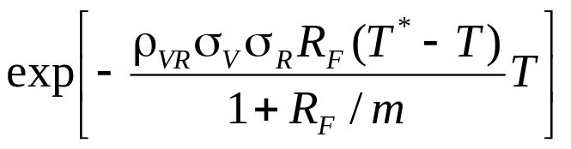
Timing Adjustments (Equation 30.3)
The expected value of a variable, V, in a world that is defined by numeraire P(0,T*) is the expected value of the variable in a world defined by numeraire P(0,T) multiplied by
where R_{F} is the forward interest rate between T and T* expressed with a compounding frequency of m, σ_{R} is the volatility of R_{F}, σ_{V} is the volatility of V, and ρ is the correlation between R_{F} and V

Slide 8
Example 30.2
A derivative provides a payoff 6 years equal to the value of a stock index in 5 years. The interest rate is 8% with annual compounding
1200 is the 5-year forward value of the stock index
This is the expected value in a world defined by numeraire P(0,5)
To get the value in a world defined by numeraire P(0,6) we multiply by 1.00535
The value of the derivative is 1200×1.00535/(1.08⁶) or 760.26

Slide 9
Quantos (Section 30.3)
Quantos are derivatives where the payoff is defined using variables measured in one currency and paid in another currency
Example: contract providing a payoff of
S_{T} – K dollars ($) where S is the Nikkei stock index (a yen number)

Slide 10
Diff Swap
Diff swaps are a type of quanto
A floating rate is observed in one currency and applied to a principal in another currency

Slide 11
Quanto Adjustment (equation 30.5)
The expected value of a variable, V, in a world that is defined by numeraire P_{X}(0,T) is its expected value in a world that is defined by numeraire P_{Y}(0,T) multiplied by exp(ρ_{VW}σ_{V}σ_{W}T)
W is the forward exchange rate (units of Y per unit of X) and ρ_{VW} is the correlation between V and W.

Slide 12
Example 30.3
Current value of Nikkei index is 15,000
This gives one-year forward as 15,150.75
Suppose the volatility of the Nikkei is 20%, the volatility of the dollar-yen exchange rate is 12% and the correlation between the two is 0.3
The one-year forward value of the Nikkei for a contract settled in dollars is 15,150.75e^{0.3 ×0.2×0.12×1} or 15,260.23

Slide 13
Quantos continued
When we move from the traditional risk neutral world in currency Y to the tradional risk neutral world in currency X, the growth rate of a variable V increases by
ρσ_{V} σ_{S}
  where σ_{V} is the volatility of V, σ_{S} is the volatility of the exchange rate (units of Y per unit of X) and ρ is the correlation between the two
        ρσ_{V} σ_{S}

Slide 14
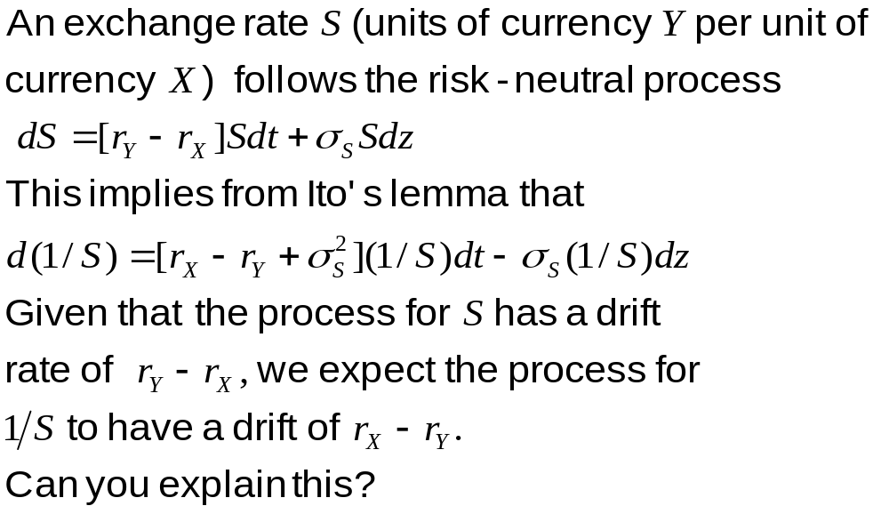
Siegel’s Paradox

Slide 15
When is a Convexity, Timing, or Quanto Adjustment Necessary: Summary
A convexity or timing adjustment is necessary when interest rates are used in a nonstandard or unnatural way for the purposes of defining a payoff
No adjustment is necessary for a vanilla swap, a cap, or a swap option

